Slide 1

Introduction to AI
Lecture 1: Introduction to AI
Jacob Howe
School of Mathematics, Computer Science and Engineering
Department of Computer Science

Slide 2
Alan Turing (1912-1954)
He is the father of AI.
The Turing test: first described in his article
“Computing machinery and intelligence”, 1950.

Slide 3
The Turing test
An interrogator is connected to one person and one machine through a terminal, and therefore can't see his counterparts.
His task is to find out which of the two candidates is the machine, and which is human only by asking them questions.
If the interrogator cannot make a decision within a certain time, the machine is considered to be intelligent.

Slide 4
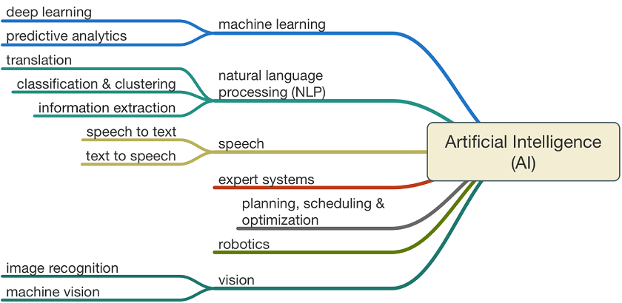
Artificial Intelligence

Slide 5
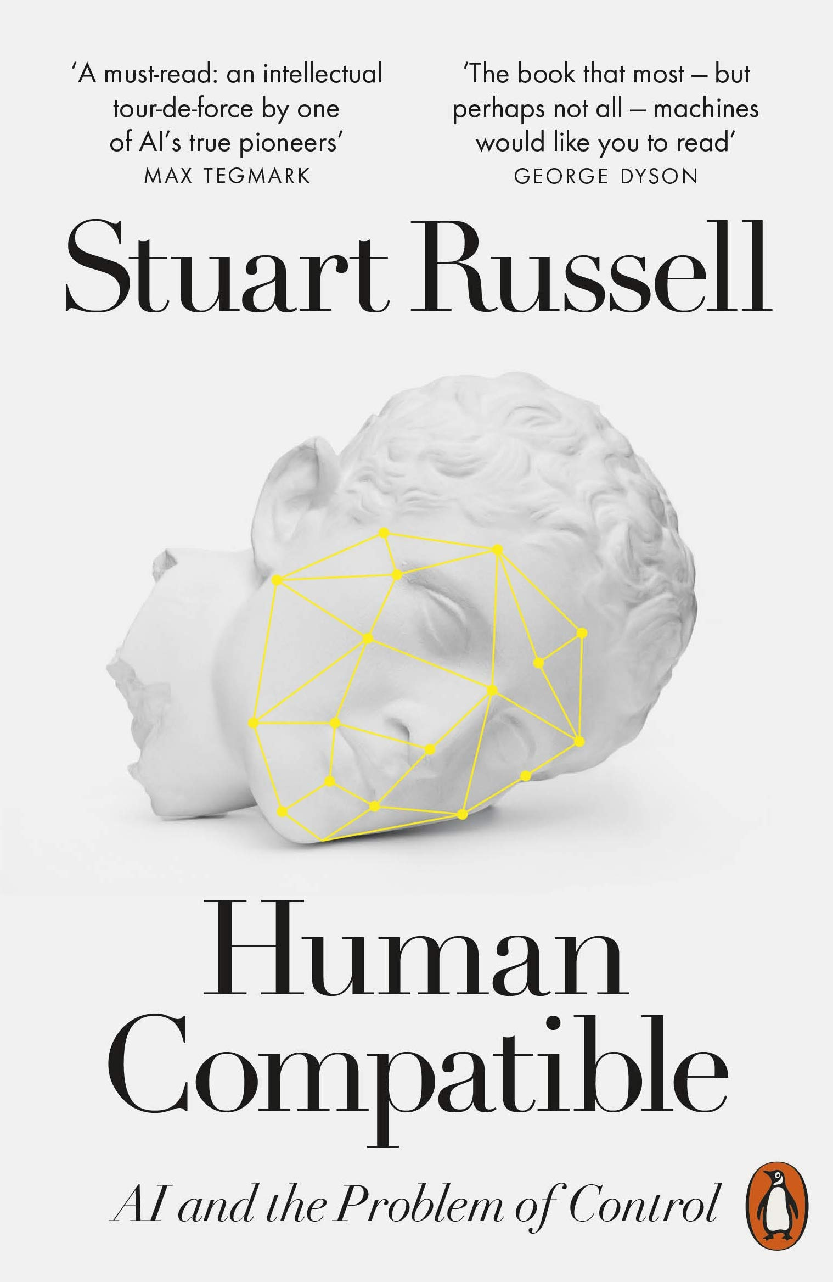
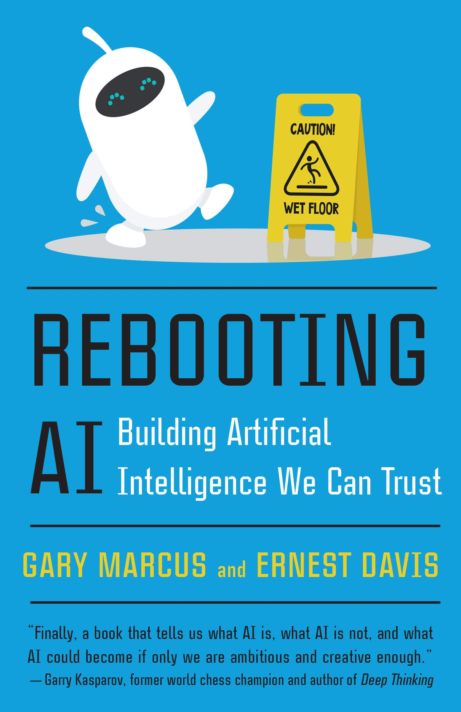
How Close is General AI?
near?
far?

Slide 6
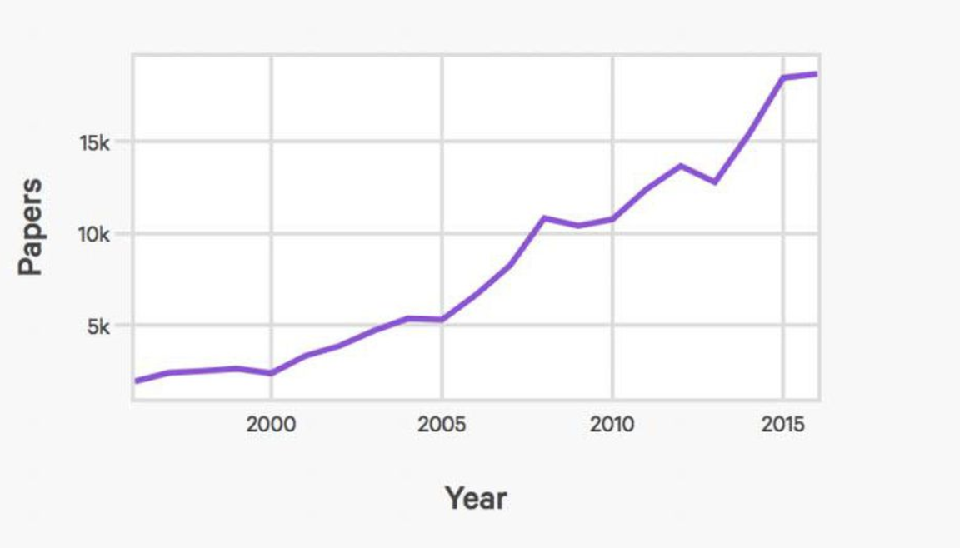
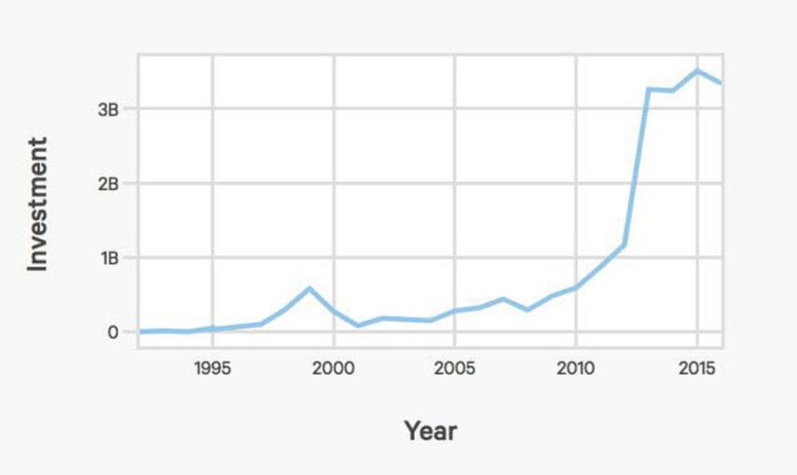
AI index (published papers, startups)
Number of published AI papers
VS investment in AI startups

Slide 7
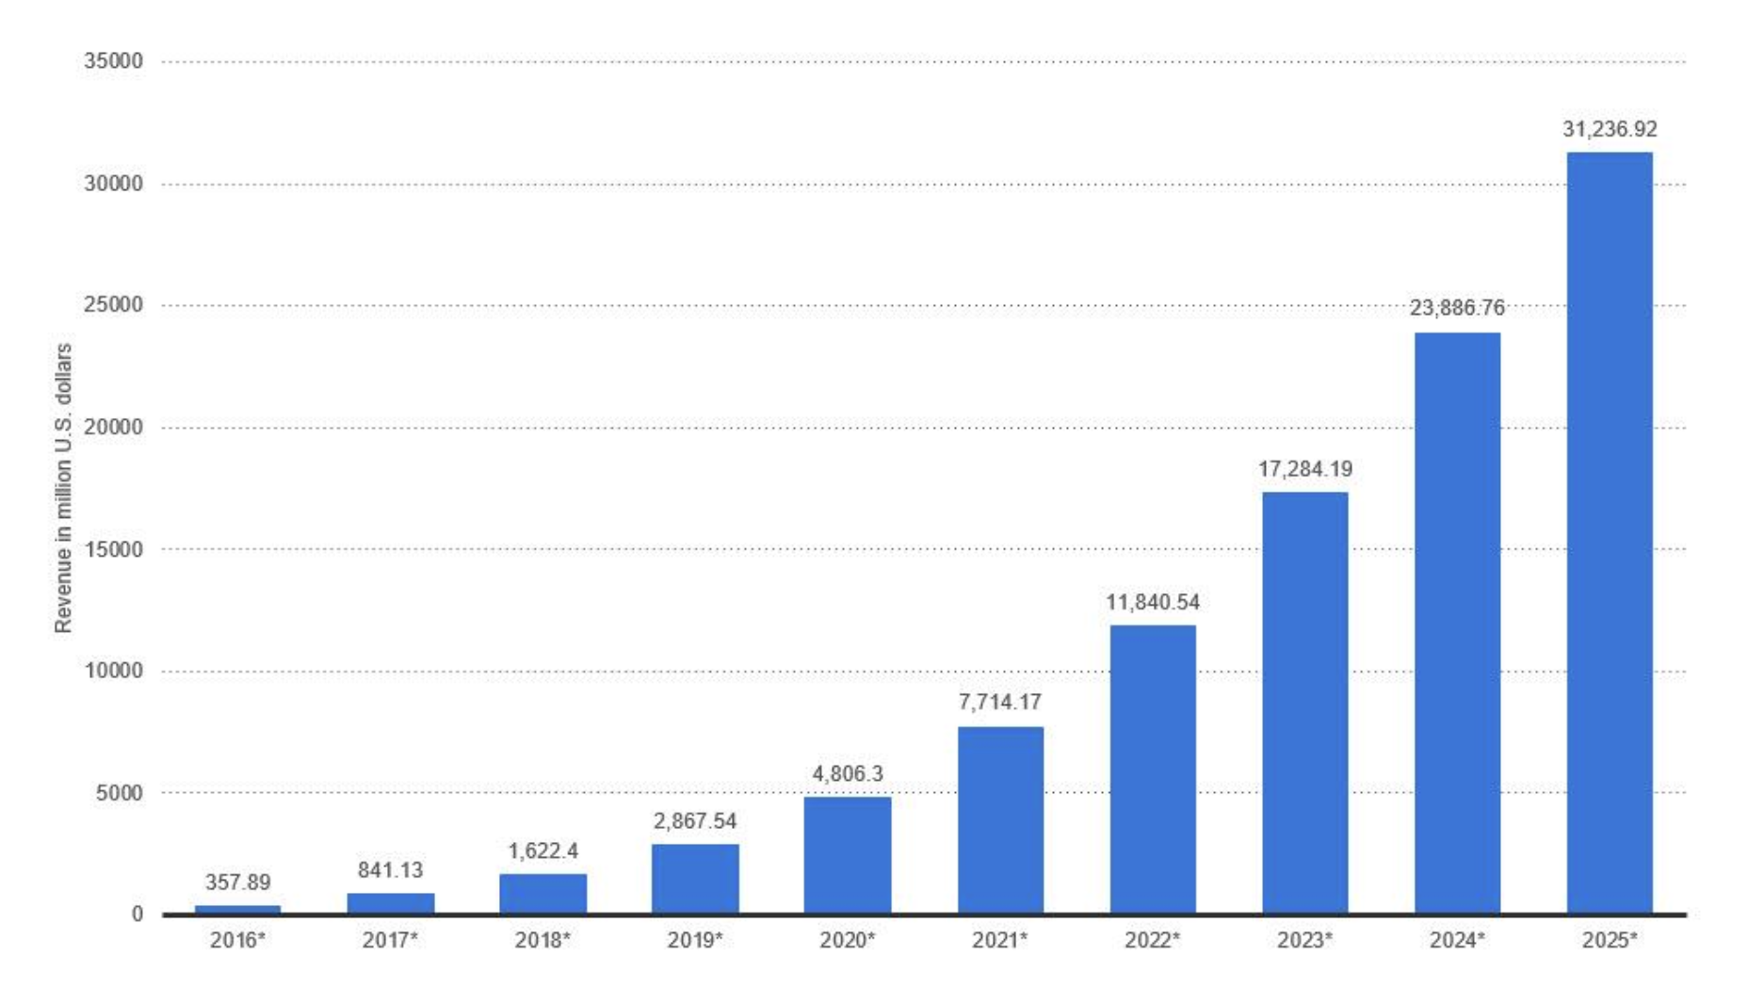
AI index (revenues)
Revenues from the AI for enterprise applications market worldwide, 2016-2025

Slide 8
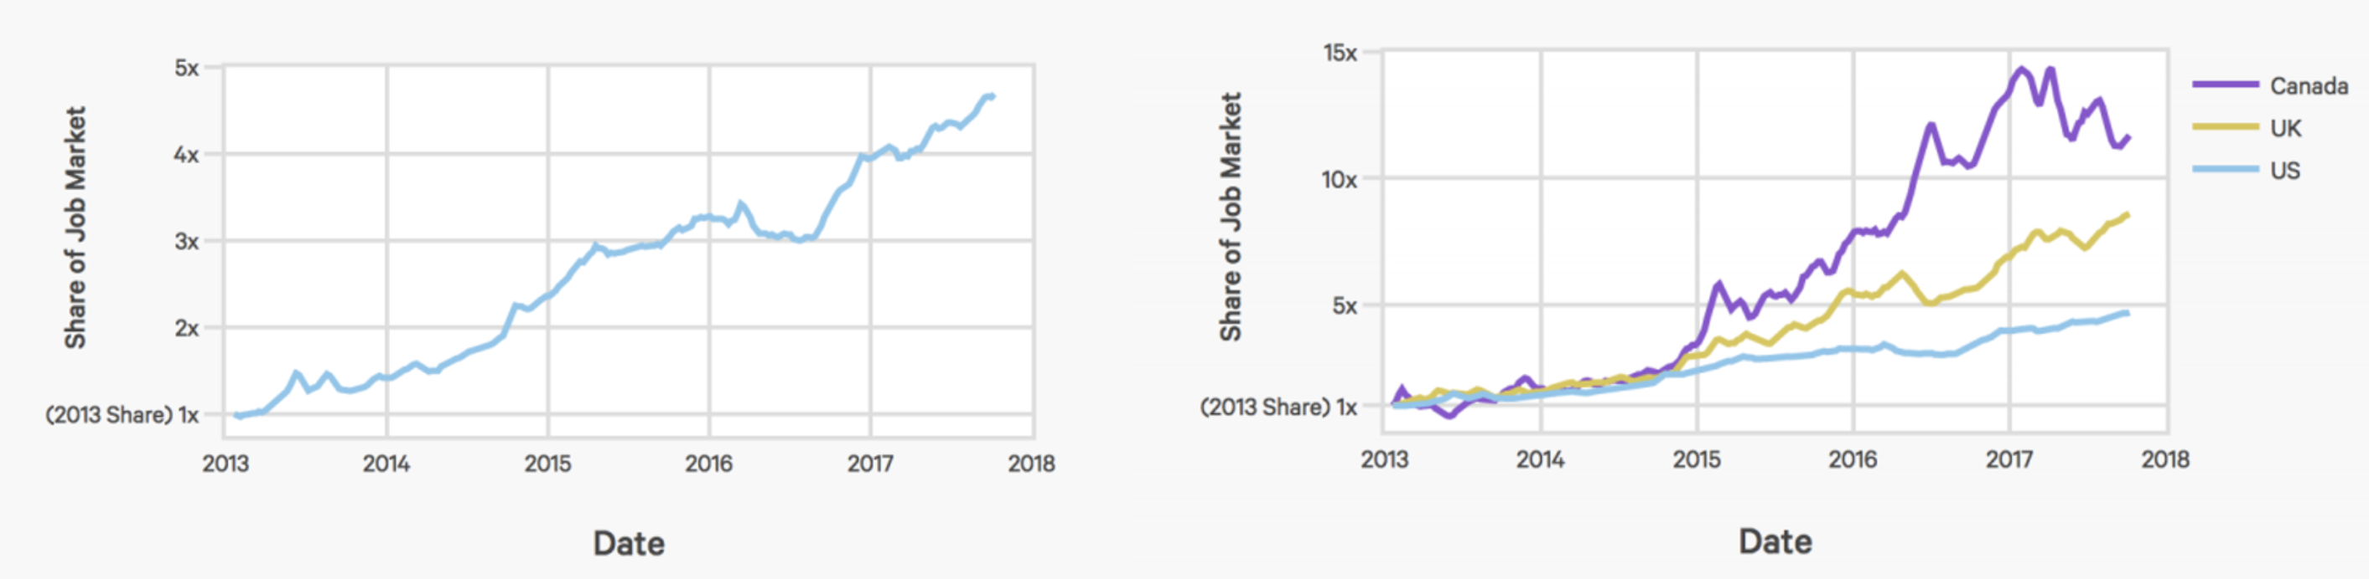
Share of jobs requiring AI skills
Share of US jobs requiring AI skills
Share of UK, US and Canada jobs
requiring AI skills

Slide 9
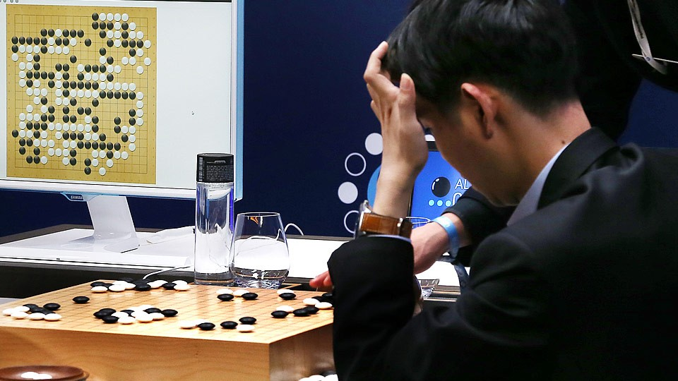
AlphaGo beats a Go world champion

Slide 10
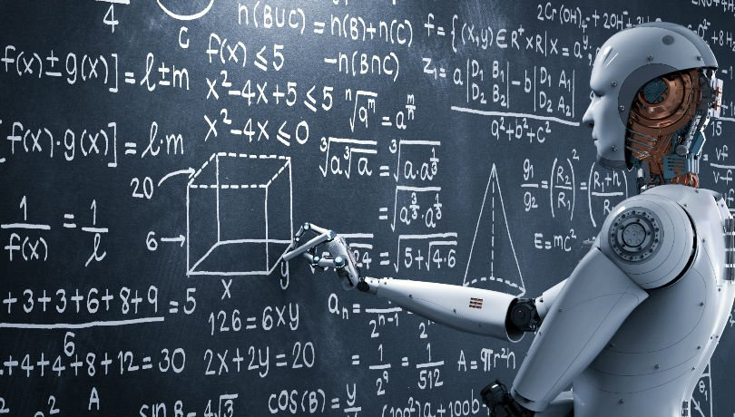
More AI applications
Signal and image processing, character recognition
Data analysis (data compression, data mining)
Medicine
Weather prediction
Computer games, robotics
Bioinformatics
Business
Financial modelling (stock market prediction)

Slide 11
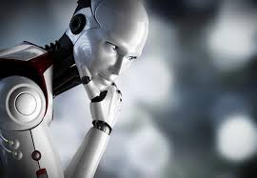
AI in our everyday life
Self-driving and parking vehicles
Self-driving and parking cars use deep learning,
a subset of AI, to recognize the space around
a vehicle (Nvidia).
2. Digital assistants
Apple’s Siri, Google Now, Amazon’s Alexa, and Microsoft’s Cortana are digital assistants that help users to perform various tasks
(from checking their schedules and searching for something on the web to sending commands to another application).

Slide 12
AI in our everyday life (cont.)
3. Social Media and Advertising
Machine learning is to target adds at you...
Automated captioning
Deep learning models are getting better and better at voice to text, as you might have seen in earlier teaching
Robots
The Roomba 980 model vacuum (the one that cleans your floor by itself) uses AI to scan the size of a living area to best way to clean the carpet.
Scheduling
Airlines, etc… use AI techniques for optimising schedules

Slide 13
AI paradox
Hard problems for people are easy for AI
e. g., symbolic integration, proving theorems,
playing chess, medical diagnosis aspects
Easy problems are hard for AI
e. g., catching prey and avoiding predators, interpreting complex sensory information (visual, aural), modelling the internal states of other animals from their behaviour, working as a team

Slide 14
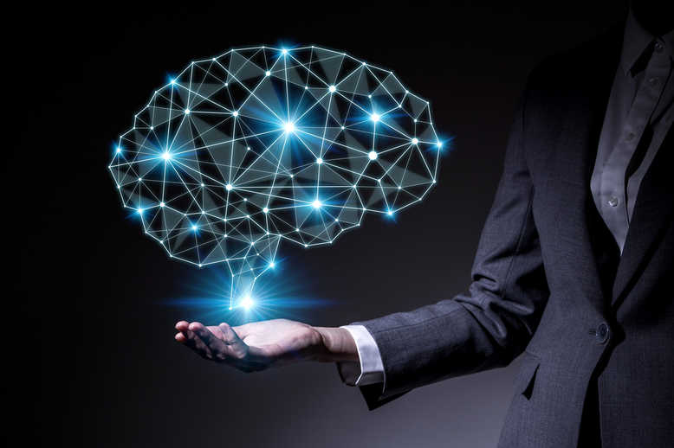
Module objective
The ”Introduction to AI" module provides the foundational principles of Artificial Intelligence, along with a survey of techniques for manipulating data, classification and pattern recognition. There is a focus on neural networks.
The module takes a practical approach, with
emphasis on building and analyzing AI,
whilst theory will also be covered.

Slide 15
Lecture Outline
What is AI?
Module Information, including development tools: Python and Libraries
Learning from data
Neural networks and the perceptron model
Training perceptrons

Slide 16
People
Lecturers:
Dr Jacob Howe (j.m.howe@city.ac.uk) [L1,2,6,7,8]
Dr Daniel Chicharro Raventos (Daniel.Chicharro@city.ac.uk) [L3,4,5,9,10]
Dr Atif Riaz (Atif.Riaz@city.ac.uk) [lab leader]
Classroom assistants: Esther Mulwa
You!
Super-module (IN3062, INM701)

Slide 17
Organisation
Lecture: Mondays, 10:00-11:50, A130 (with a break in the middle)
Classes (programming tutorials and exercises), all in ELG06/07:
INM701: Monday 12:00-12:50
IN3062:
Lab 2: Monday 13:00-13:50
Lab 1: Monday 14:00-14:50
Drop in: ELG06/07, Monday 15:00-15:50
Look out for office hours for Jacob, Daniel and Atif

Slide 18
Organisation
Lecture: Themes, models and theory
Labs: Coding and data, with walk through tutorials, homework exercises
Use the discussion board
Mini-MCQs

Slide 19

Assessment
Lectures (slides and all other material on Moodle)
Labs (all material on Moodle)
Coursework counts 100%, no exam
Working in pairs
Homework
Task: find sources of data and perform your own implementations to illustrate and expand on things we learn in the module.
Submission: report, code (github)

Slide 20
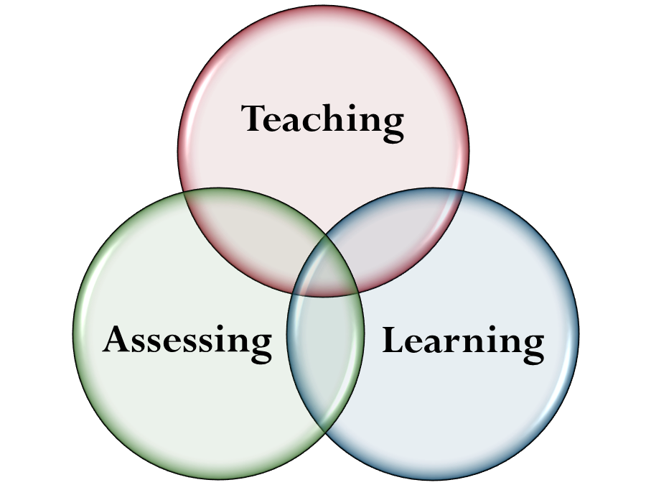
Study Hours and Assessment
15 Credit Module represents 150 hours of work
Lectures and labs represent 30 hours
Self-directed study 70-80 hours
Coursework 40-50 hours (each)
Deadline 5pm Wednesday December 29th
Presentations for INM701
You need to distribute your time over 3 months

Slide 21
Coding
Python is the main programming language for this module (prefer Python 3.8)
Be sure to install the essential packages and libraries for numerical computation in Python:
TensorFlow
Keras
Numpy
Matplotlib
Pandas
Scikit-learn

Slide 22
Why Python?
Extensive support libraries: Python has a large number of AI libraries built in
Support: Python is a fully open source
Productivity: Python is an excellent option for developing scalable multi-protocol network applications
Flexibility: Python is good for connecting various data structures
Popularity: Python is one of the most popular languages for today

Slide 23
Coding
To install Python for Windows you can use Anaconda Distribution:
please, go to this https://www.anaconda.com/download/#windows
download Python 3.8 version graphical installer (32/64-bit depending on your system)
follow this guide
https://docs.anaconda.com/anaconda/install/windows
To install Python for Mac OS:
please, go to this https://www.anaconda.com/download/#macos
click on the Python 3.8 version 64-bit Graphical Installer
follow this link to install the navigator on your Mac:
https://docs.anaconda.com/anaconda/install/mac-os#macos-graphical-install

Slide 24
Coding IDEs
Jupyter Notebook and Spyder are used for programming in Python in this module.
Jupyter Notebook works well as a presentation or education tool, and labs will be presented using this.
Spyder is very intuitive IDE for scientific computing and integrates NumPy, SciPy, Matplotlib and IPython. You should use this for your development work.
Sample code from the internet can be used but must be referenced if you include it in your work.

Slide 25
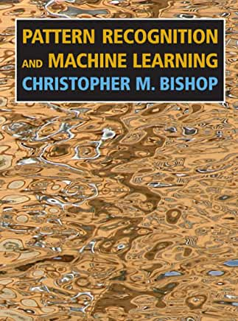
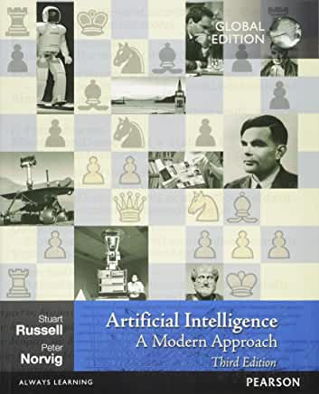
Books

Slide 26
Books
You can get the online version of Bishop for free here:
https://www.microsoft.com/en-us/research/uploads/prod/2006/01/Bishop-Pattern-Recognition-and-Machine-Learning-2006.pdf
A 4th edition of Russell and Norvig has recently come out, and the chapter structure is not the same
Also, ”Deep Learning,” Goodfellow, Bengio and Courville. MIT Press, 2016
https://www.deeplearningbook.org

Slide 27
Module Outline
Introduction and Perceptron + python (L1)
Data, Decision Trees and Performance Measures (L2)
Correlation, Regression and Support Vector Machines (L3)
Unsupervised learning: PCA and clustering (L4)
Classification: kNN, Random Forest, Naïve Bayes (L5)
Neural Networks: Multi-layer Perceptron (L6,L7)
Convolutional Neural Networks (L8)
Genetic Algorithms (L9)
Tbc (L10)

Slide 28
AI paradox
Hard problems for people are easy for AI
e. g., symbolic integration, proving theorems,
playing chess, medical diagnosis aspects
Easy problems are hard for AI
e. g., catching prey and avoiding predators, interpreting complex sensory information (visual, aural), modelling the internal states of other animals from their behaviour, working as a team

Slide 29
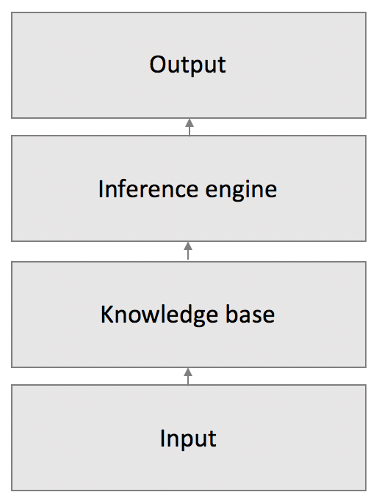
Knowledge-based AI
AI heavily depends on representation of the given data.
People try to formalize the rules with enough complexity to describe everything.

Slide 30
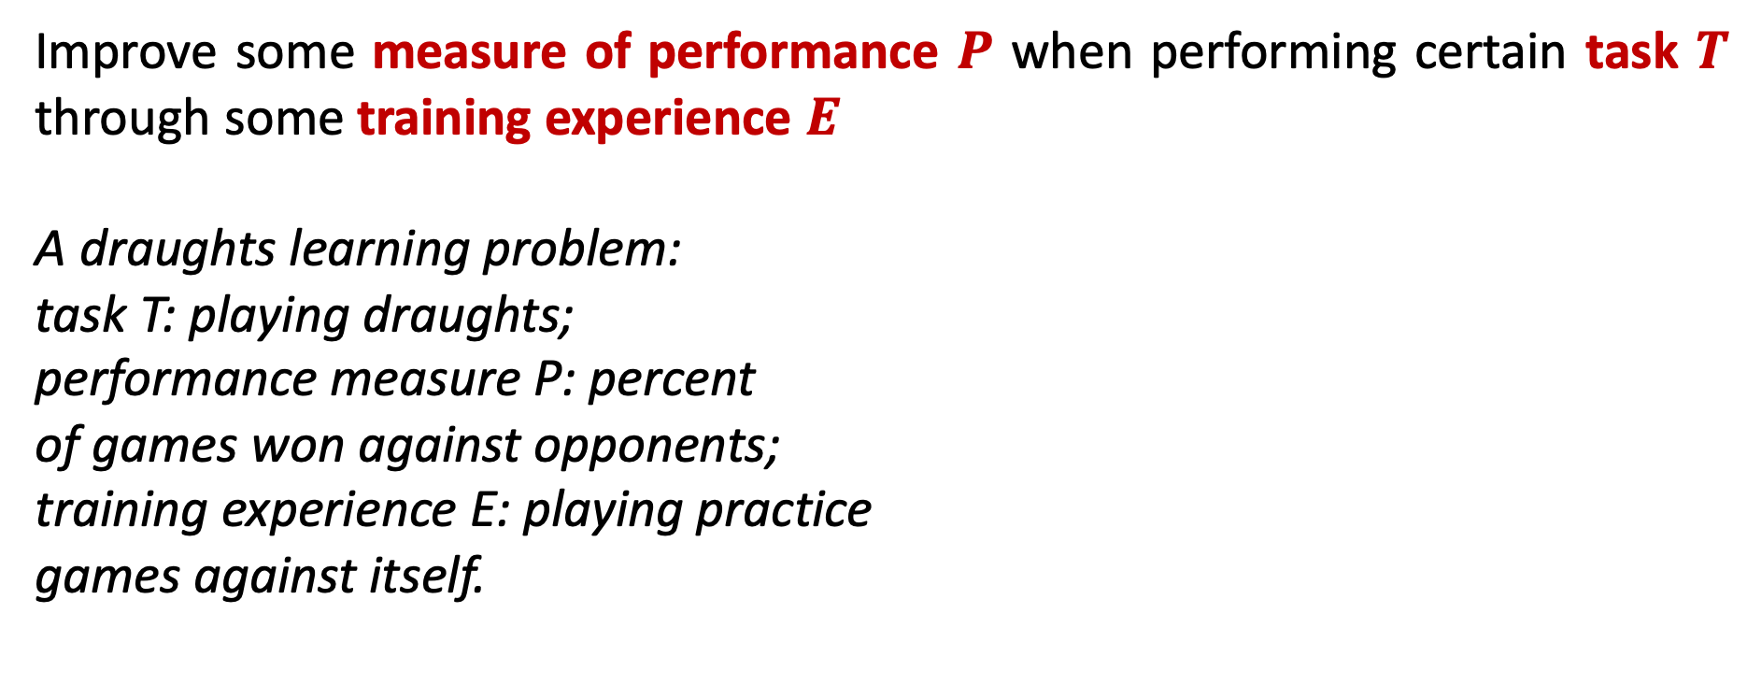
Learning problem definition
Improve some measure of performance $P$ when performing certain task $T$ through some training experience $E$
A draughts learning problem:
task T: playing draughts;
performance measure P: percent
of games won against opponents;
training experience E: playing practice
games against itself.

Slide 31
AI paradigm shift
Knowledge-based systems cannot process simple recognition tasks
Simple machine learning methods
cannot process complex recognition
tasks
Deep learning methods

Slide 32
Machine learning approach
Important part of learning is that if all done properly, the trained model will produce good predictions beyond the set of training examples. This is called generalization.
Collection of data: samples
Selection of the model: probability distribution to model process
Estimation of parameters: values/distributions
Inference: find answers to requests

Slide 33
End-to-end AI project
Working with real data
Looking at the big picture
Getting the data
Discovering and visualizing the data to gain insights
Preparing the data for AI algorithms
Selecting and training a model
Fine-tuning your model
Launching, monitoring, and maintaining your system
Trying it out!

Slide 34
Problem types
Based on type of data:
supervised learning (learning with an external teacher)
unsupervised learning (learning with no help)
[reinforcement learning (learning with limited feedback)]
Based on type of output: regression, classification
Based on type of model: generative, discriminative

Slide 35
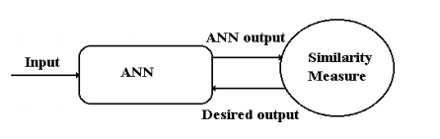
Types of learning (supervised learning)
the input data and the corresponding output data/labels are given;
the ANN (or other model) learns to approximate the function from the inputs to the outputs.

Slide 36
Types of learning (unsupervised learning)
only input is given;
the model learns to form internal representations or codes for the input data that can then be used e.g. clustering.

Slide 37
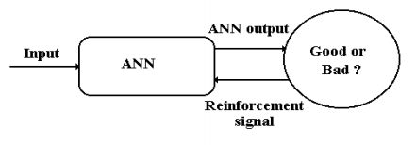
Types of learning (reinforcement learning)
the input vectors and a reinforcement signal are given;
the reinforcement signal tells how good the true output was.

Slide 38
Supervised learning (classification)
The input is a labelled dataset
The labels correspond to the class the data point belongs to
For a given model of AI, the models is trained to fit the dataset (as best it can)
The trained model can then be applied to new data points

Slide 39
ANNs: role in modern AI
Artificial Neural Networks (ANNs)
Brain modelling
Models construction of how the human brain works to understand the nature of learning, perception, actions, memory and thinking, to formulate medical solutions for patients with brain damage.
Artificial system construction
Efficient systems building for real world applications. This makes machines more powerful and intelligent.

Slide 40
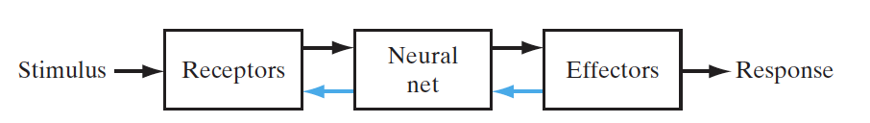
Nervous system structure
The neural net (brain) continually receives information, perceives it and makes appropriate decisions.
The receptors convert stimuli from the external environment into electrical impulses that transform information to the neural net.
The effectors convert electrical impulses generated by the neural net into responses as system outputs.

Slide 41
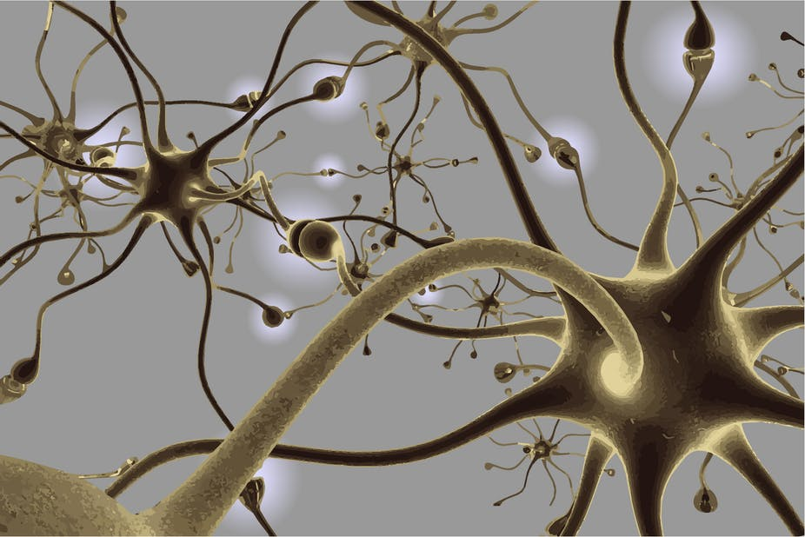
Nervous system (microscopic view)

Slide 42
Nervous system (microscopic view, cont.)
Nervous system is made up of cells.
A cell has a fatty membrane, which is filled with liquid and proteins known as cytoplasm as well as smaller functional parts called organelles.
There are two major types of brain cells: neurons and glia
neurons are the main elements involved in information processing in the brain;
glia provide support and homeostasis to neurons.

Slide 43
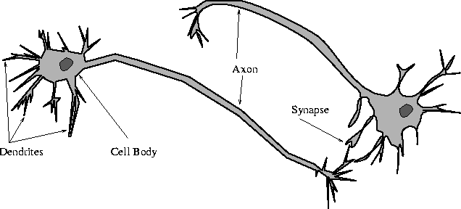
Biological neural network
The basis computational unit in the nervous system is a nerve cell or the neuron.
A neuron has: dendrites (inputs), cell body, axon (output).
The human brain contains about 10 billion neurons.
On average, each neuron is connected to other neurons through about 10000 synapses.

Slide 44
Biological neural network (cont.)
The neuron’s cell body (soma) processes the incoming activations and transforms them into output activations.
Dendrites are fibres which occur from the cell body, ensure the receptive zones that receive activation from other neurons.
Axons are fibres that work as the transmission lines: transform action potentials to other neurons.
Synapses are the junctions that allow signal transmission between the axons and the dendrites.

Slide 45
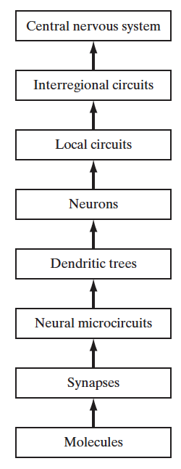
Structural organization of levels in the brain
Organization levels that emerged from the analysis of local regions in the brain:

Slide 46
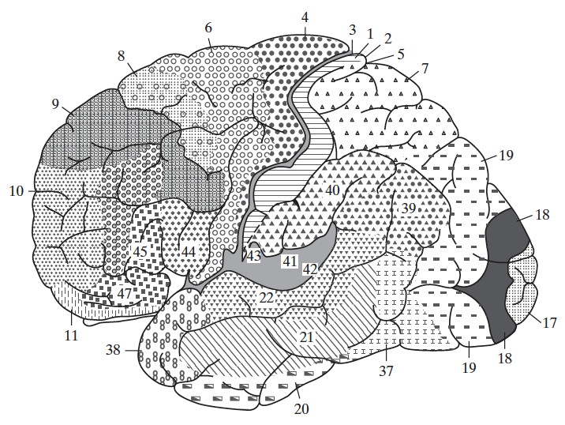
A cytoarchitectural map of the cerebral cortex
The different areas are identified by the thickness of their layers and types of cells within them.
Motor cortex: motor strip - 4;
premotor - 6; frontal eye fields - 8.
Somatosensory cortex: 3, 1, and 2.
Visual cortex: 17, 18, and 19.
Auditory cortex: 41 and 42.
(from A. Brodal, 1981; with permission of Oxford University Press)

Slide 47
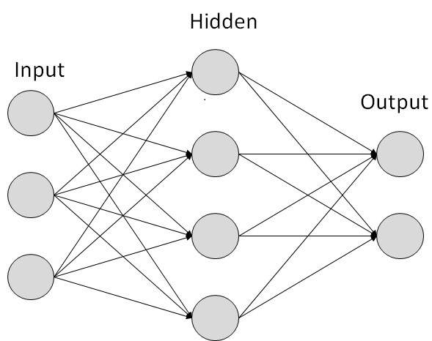
Artificial neural network
Artificial neurons are crude approximations of the neurons found in real brains. They may be mathematical constructs or physical devices.
Artificial neural networks (ANNs) are networks of artificial neurons.

Slide 48
Artificial neural network (cont.)
Artificial neural network characterized by:
pattern of connections between the neurons
(called its architecture)
method of determining the weights on the connections
(called its training, learning or algorithms)
activation function

Slide 49
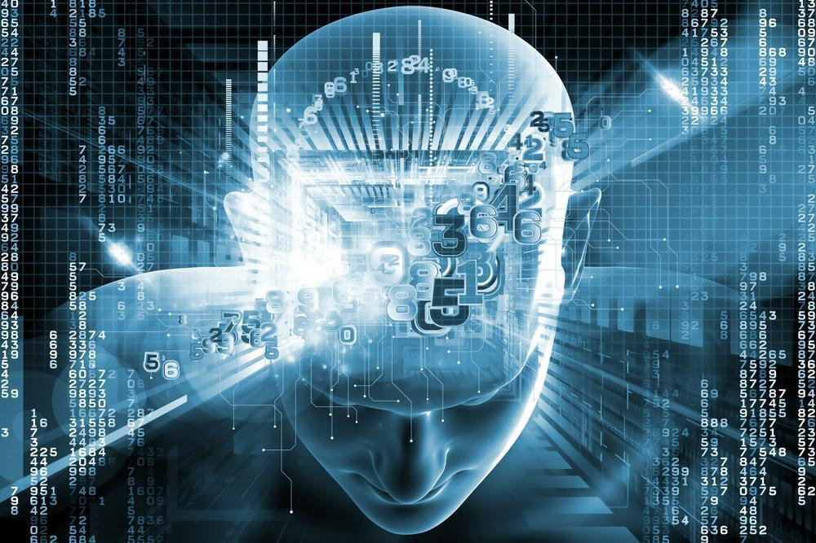
History of neural networks
McCulloch and Pitts (1943)
introduced the idea of neural
networks as computing machines.
Hebb (1949) postulated the first rule
for self-organized learning.
Rosenblatt (1958) proposed the perceptron as the first model for
learning with a teacher (i.e., supervised learning).
Grossberg (1980) introduced his Adaptive Resonance Theory (ART).

Slide 50
History of neural networks (cont.)
Hopfield (1982) published a series of papers on Hopfield networks.
Kohonen (1982) developed the self-organizing feature maps.
Back-propagation learning algorithm for multi-layer perceptrons was rediscovered (1986).
Support vector machines were developed (late 1990s into 2000s).
Convolutional Neural Networks trained with backpropagation (LeCun, et al 1989)
Gated Recurrent Units (GRU), (Cho et al 2014)

Slide 51
Artificial neural network (cont.)
Most properties of NNs do not arise from the functionality of each neuron, but from the effect of the interconnection of neurons.
single-layer feed-forward NNs: one input layer and one output layer of processing units. No feedback connections.
multi-layer feed-forward NNs: one input layer, one output layer, and one or more hidden layers of processing units. No feedback connections.
recurrent NNs: any network with at least one feedback connection. It may, or may not, have hidden units.

Slide 52
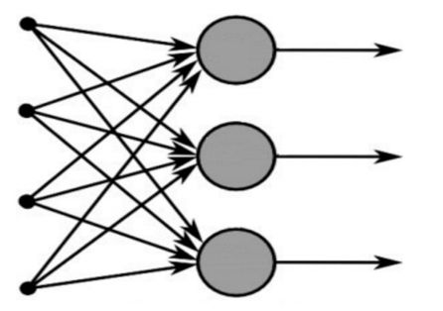
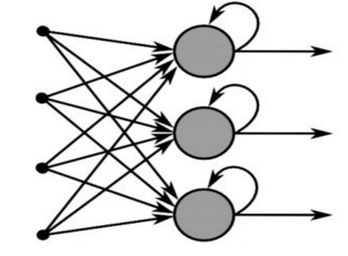
Types of neural networks
Feed-forward
Single-layer perceptron
Multi-layer perceptron
Radial basis function
Recurrent
Competitive networks
Kohonen’s SOM
Hopfield network, ART models

Slide 53
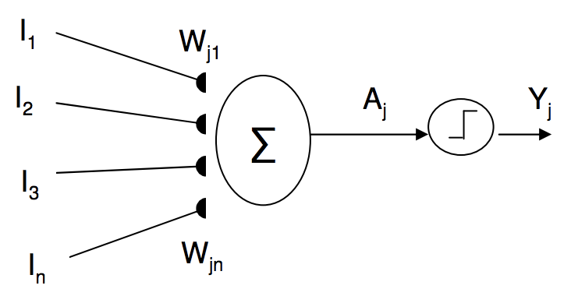
McCulloch-Pitts neuron
Also known as a linear threshold gate:
A synapses set (connections) inputs activations from other neurons.
A processing unit sums the inputs, producing an activation level, and then a non-linear activation function is applied.
An output line passes the result to other neurons.

Slide 54
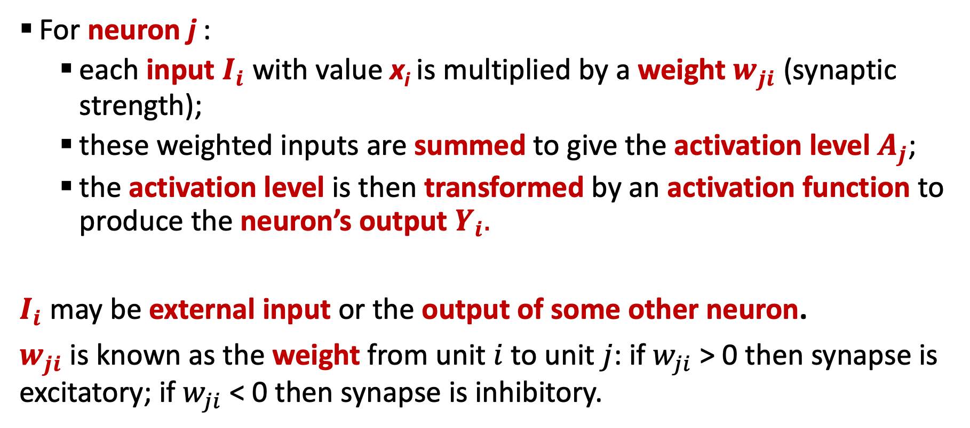
How the neuron model works?
For neuron j :
each input $I_{i}$ with value x_{i} is multiplied by a weight $w_{ji}$ (synaptic strength);
these weighted inputs are summed to give the activation level $A_{j}$;
the activation level is then transformed by an activation function to produce the neuron’s output $Y_{i}.$
$I_{i}$ may be external input or the output of some other neuron.
$w_{ji}$ is known as the weight from unit $i$ to unit $j$: if $w_{ji}$ > 0 then synapse is excitatory; if $w_{ji}$ < 0 then synapse is inhibitory.

Slide 55
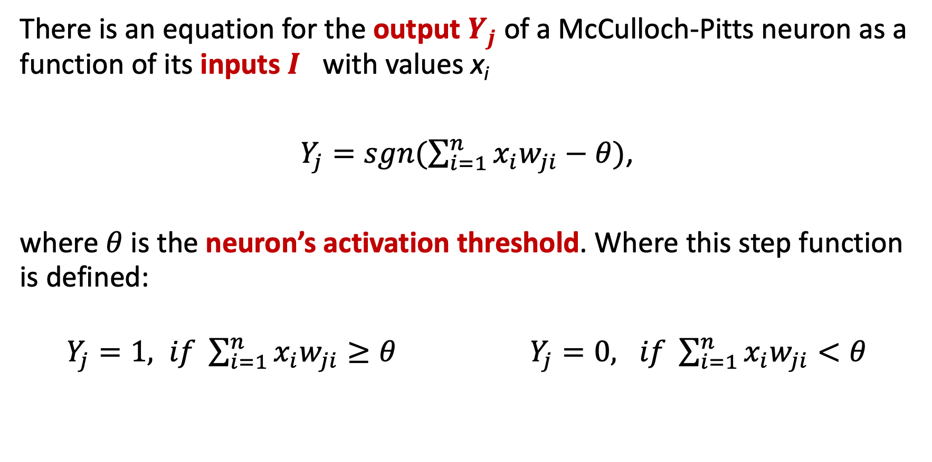
The McCulloch-Pitts neuron equation
There is an equation for the output $Y_{j}$of a McCulloch-Pitts neuron as a function of its inputs $I_{}$with values x_{i}
$Y_{j}=sgn(\sum_{i=1}^{n}{x_{i}w_{ji}−θ})$,
where $θ$is the neuron’s activation threshold. Where this step function is defined:
$Y_{j}=1, if \sum_{i=1}^{n}{x_{i}w_{ji}≥θ}$ $Y_{j}=0, if \sum_{i=1}^{n}{x_{i}w_{ji}<θ}$

Slide 56
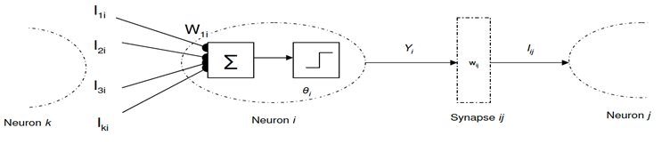
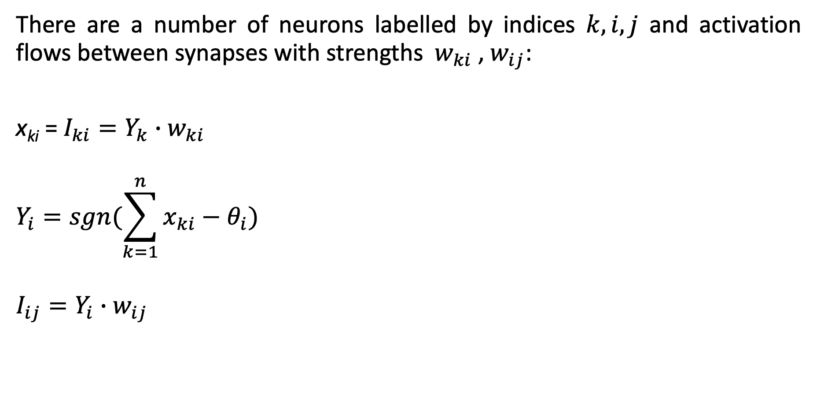
Networks of McCulloch-Pitts neurons
There are a number of neurons labelled by indices $k, i,j$ and activation flows between synapses with strengths ${ w}_{ki}$,${ w}_{ij}$:
x_{ki} = $I_{ki}=Y_{k}∙w_{ki}$
$$Y_{i}=sgn(\sum_{k=1}^{n}{x_{ki}−θ_{i}})$$
$$I_{ij}=Y_{i}∙w_{ij}$$

Slide 57
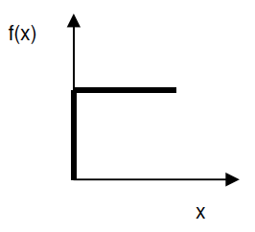
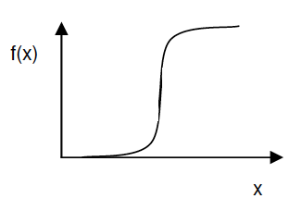
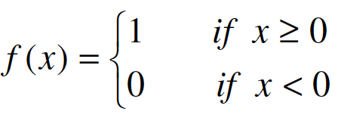
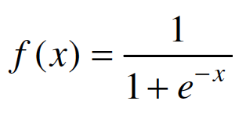
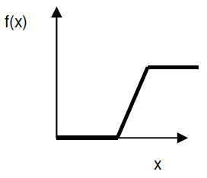
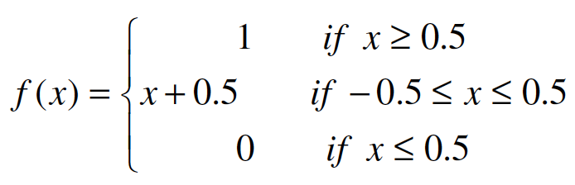
Types of the activation functions
1) threshold 2) sigmoid
3) piecewise-linear

Slide 58
Perceptron
The perceptron is the simplest form of a neural network in which patterns are classified as linearly separable (i.e. patterns on opposite sides of a hyperplane). It is closely related to the McCulloch-Pitts neuron
It consists of a single neuron with
adjustable synaptic weights and bias.
x₁
x₂
…
x_{n}
w₁
w₂
w_{n}
f

Slide 59
Perceptron
The bias is usually incorporated as an extra input, x₀, where the input value is always 1. Function f represents the activation function.
The inputs themselves might be
transformed by some other
function 𝜙
x₀
x₁
x₂
…
x_{n}
w₀
w₁
w₂
w_{n}
f

Slide 60
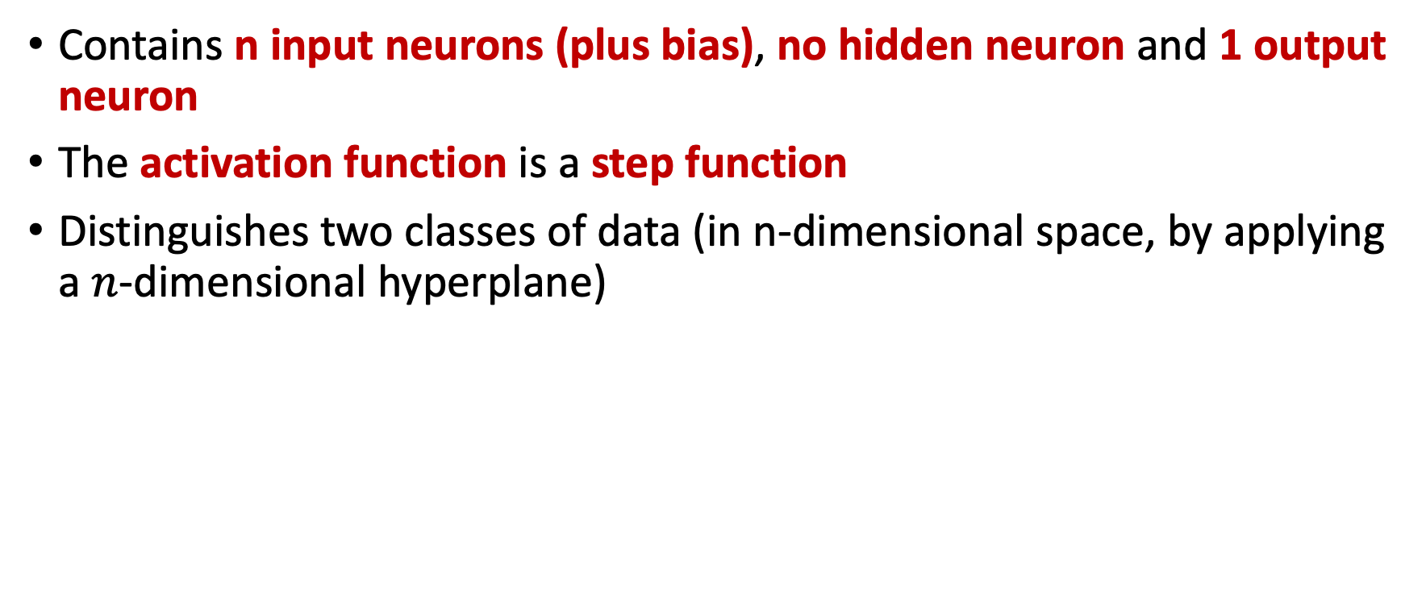
Perceptron
Contains n input neurons (plus bias), no hidden neuron and 1 output neuron
The activation function is a step function
Distinguishes two classes of data (in n-dimensional space, by applying a $n$-dimensional hyperplane)
x₀
x₁
x₂
…
x_{n}
w₀
w₁
w₂
w_{n}
f

Slide 61
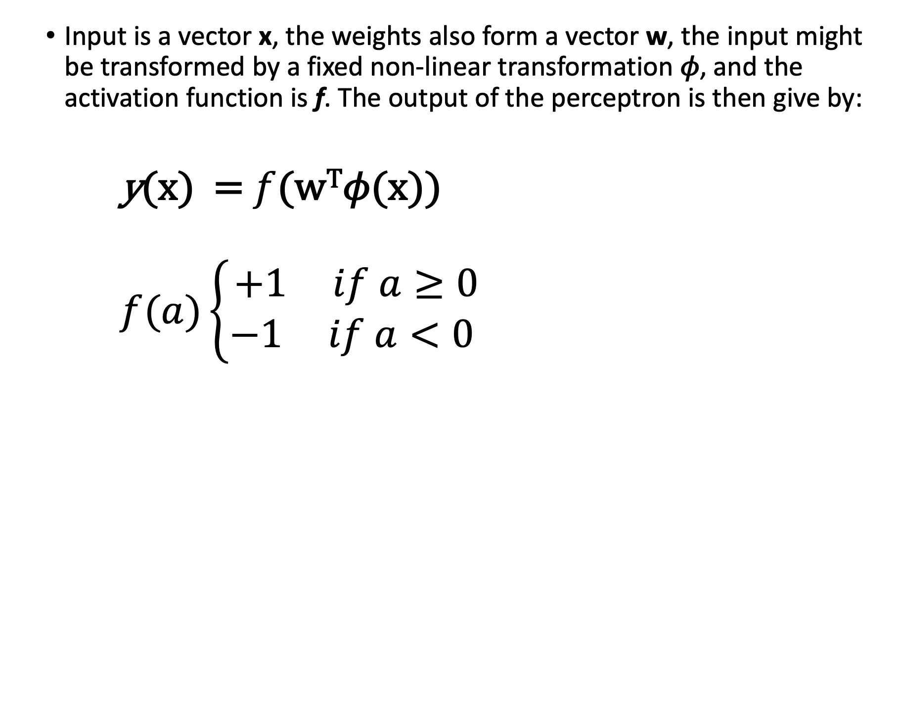
Perceptron
Input is a vector x, the weights also form a vector w, the input might be transformed by a fixed non-linear transformation 𝜙, and the activation function is f. The output of the perceptron is then give by:
y(x) = $f$(w^{T}𝜙(x))
$f(a)\left\{\begin{aligned}+1 if a≥0 \\ −1 if a<0 \end{aligned}\right.$
x₀
x₁
x₂
…
x_{n}
w₀
w₁
w₂
w_{n}
f

Slide 62
Perceptron Training
With the equation for the output, y(x), the perceptron can classify data in n-dimensional space, being one class if the output is positive, and another if it is negative.
Given a dataset, how do you find a set of weights w that give a classifier?
That is, how do you train it?
x₀
x₁
x₂
…
x_{n}
w₀
w₁
w₂
w_{n}
f

Slide 63
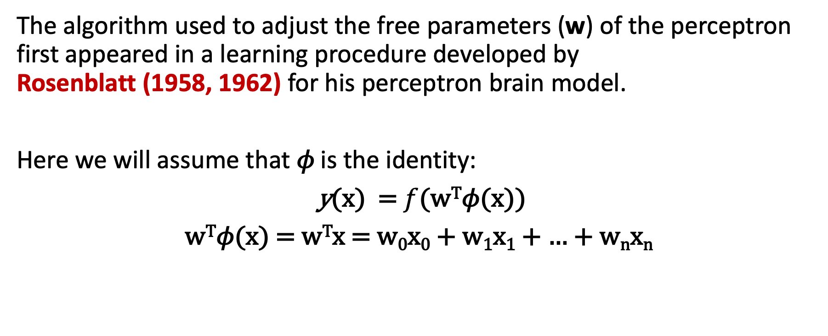
Perceptron Training
The algorithm used to adjust the free parameters (w) of the perceptron first appeared in a learning procedure developed by Rosenblatt (1958, 1962) for his perceptron brain model.
Here we will assume that 𝜙 is the identity:
y(x) = $f$(w^{T}𝜙(x))
w^{T}𝜙(x) = w^{T}x = w₀x₀ + w₁x₁ + … + w_{n}x_{n}

Slide 64
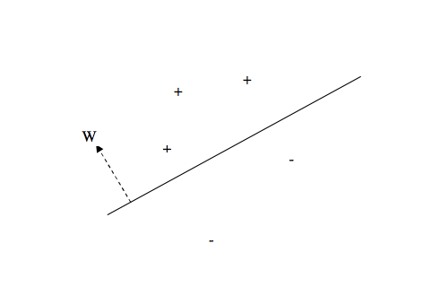
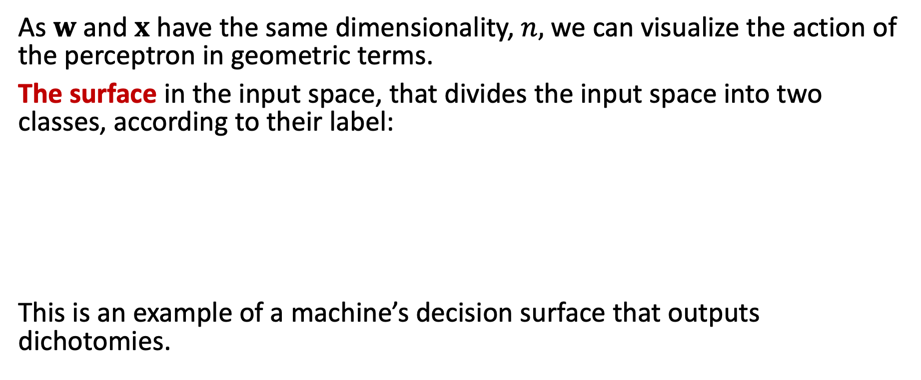
Perceptron’s decision surface
As $w$ and $x$ have the same dimensionality, $n,$ we can visualize the action of the perceptron in geometric terms.
The surface in the input space, that divides the input space into two classes, according to their label:
This is an example of a machine’s decision surface that outputs dichotomies.

Slide 65
Perceptron Training
Given a dataset, the goal is to find a perceptron that will correctly classify these points (and other unseen points)
Initially, a random set of weights is chosen, and the perceptron training algorithm updates these until the perceptron is trained
To make an update, a element of the dataset is chosen at random
If this is correctly classified by the perceptron, no change is made
If it is not, then the weights are updated, reducing the error in the model

Slide 66
Perceptron Training
For misclassified point x, the update is made as follows, where w_{i}’ is the update of weight w_{i}
w_{i}’ = w_{i} + y(x)x_{i}
Note that again transformation 𝜙 is assumed to be the identity

Slide 67
Perceptron Training
Repeated application of this rule is guaranteed to terminate, assuming that the points are linearly separable
The algorithm has been trained to fit the data
This might take some time
There is usually more than one possible answer (separating hyperplane)
Different runs of the training algorithm might lead to different solutions

Slide 68
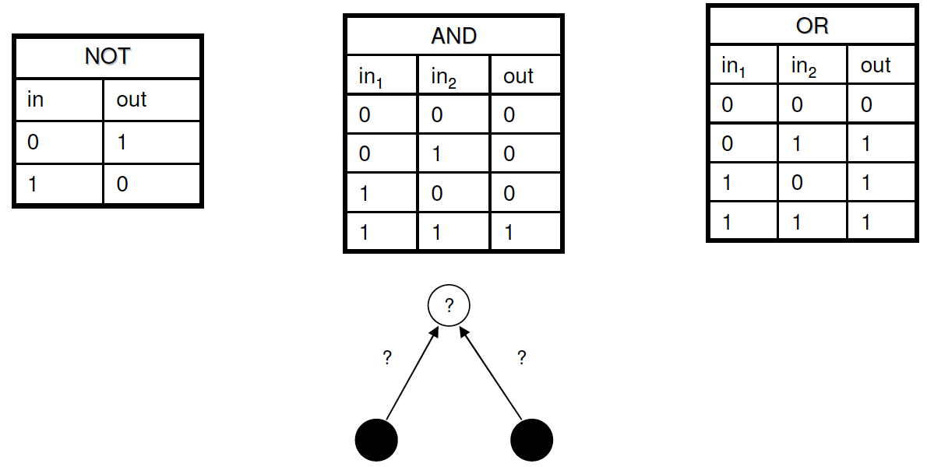
Example 1: logical NOT, AND and OR
Our task is to form decision boundaries between classes, i.e. train network to compute the corresponding weights and thresholds to classify classes correctly.

Slide 69
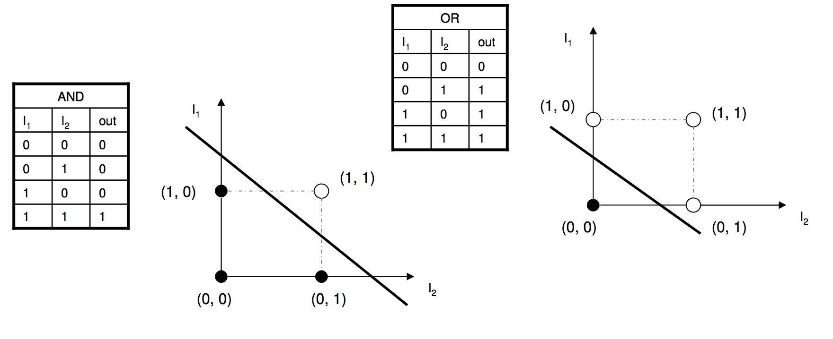
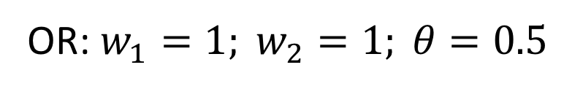
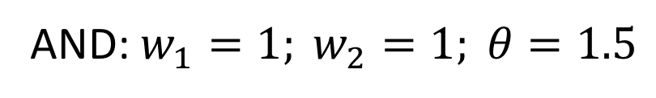
Example 1: logical AND, OR (cont.)
AND: $w_{1}=1; w_{2}=1; θ=1.5$
OR: $w_{1}=1; w_{2}=1; θ=0.5$

Slide 70
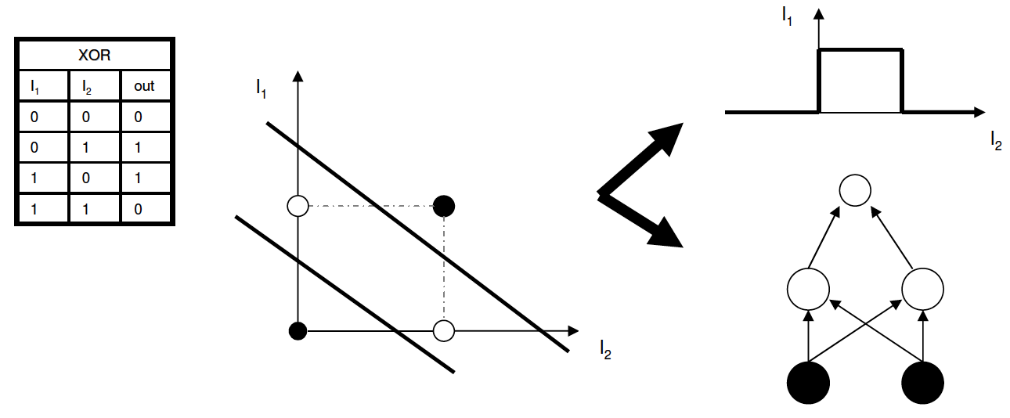
Example 2: XOR
For XOR we have to build 2 straight lines to separate the different outputs or decisions:
2 ways to solve:
changing the transfer function
to have more than one decision
boundary;
2) using a more complex network to generate more complex decision boundaries.

Slide 71
Summary​
In this module, you will learn the foundations of AI and ML, understand how to build the neural networks and to lead the successful AI projects.
In particular, you will learn about classification and regression problems, training models, MLP and more.
You will master not only the theory, but also see how it is applied. You will practice all these ideas in Python, including Tensorflow via Keras.
You have seen a first model in terms of the perceptron

Slide 72
References
Alan M. Turing. Computing Machinery and Intelligence, Mind, LIX (236): 433–460, https://www.csee.umbc.edu/courses/471/papers/turing.pdf
Christopher M. Bishop. Neural Networks for Pattern Recognition. Cambridge. UK. 1995. Section 4.1.7 for perceptrons
Stuart Russell and Peter Norvig. Artificial Intelligence, a Modern Approach (3rd edition). Pearson, 2009. Chapter 1 (history of AI), Section 18.7.1, 18.7.2

